Slide 1
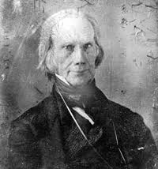
Chapter 12: Second War for Independence & the Upsurge of Nationalism, 1812-1824

Slide 2
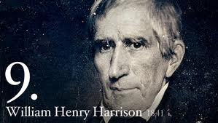
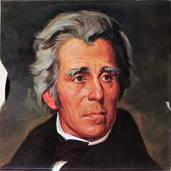
War of 1812 Military Highlights
Ch. 11 Review - Battle of Tippecanoe:
William Henry Harrison defeats Native Americans
Battle of New Orleans:
2 weeks AFTER Treaty of Ghent, Andrew Jackson defeats British
HUGE INCREASE IN NATIONALISM
Francis Scott Key – “Star Spangled Banner”
“Oh, say can you see…”
Treaty of Ghent: (HENRY CLAY!!!!)
Ended war: armistice, no gains or losses

Slide 3
Hartford Convention (1814)
Purpose: Discuss their complaints and seek compensation for losses during the war.
Federalists or Anti-Federalists?
How do you know?
Some delegates urged secession
Proposed amendment to Constitution: 2/3 of Congress must agree for embargo, new states to be admitted, or war to be declared
This was the deathblow for the Federalist Party
Why?
Most of America experienced a sense of NATIONALLSIM!!!
Federalists were creating “faction” and appeared greedy

Slide 4

“The American System”
Tariff of 1816:
first tariff in American history instituted to protect industries, not raise revenue
Henry Clay’s (Speaker of the House) American System (Know all 3 parts!!!)
Strong Banking system (provide credit) Bank of the US
Protective tariff which would help industries
Network of roads and canals, esp. in Ohio, valley that would help link the country together
Democratic-Republicans felt it was unconstitutional.
Remember:
B ank of US (2nd)
I nternal Improvements
T arrifs (1816 – 1st Protective Tariff)

Slide 5
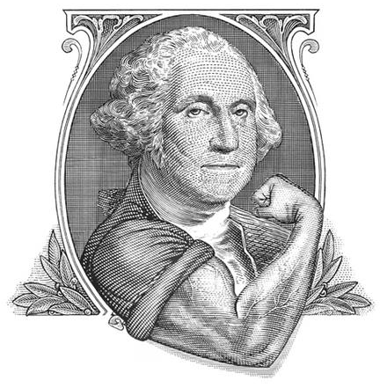
“Era of Good Feelings”
James Monroe’s Presidency (1816-1824)
Previously Secretary of State under Madison
Term coined by Boston newspaper, death of the Federalist party
Result = 1 political party (for a while)
Some issues including; slavery, panic of 1819
Causes of Panic of 1819:
Immediate cause: OVERSPECULATION on frontier lands by banks (especially BUS)

Slide 6
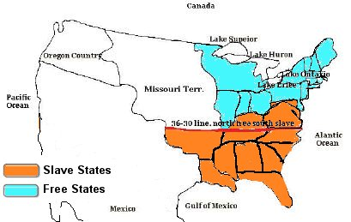
The Uneasy MO Compromise
ME = Free, MO = Slave
Balance between free and slave states at 12
36˚30’: everything above would prohibit slavery
Most of US above that line
Helps contribute to sectional differences
MO Compromise lasted for 34 years

Slide 7
MARSHALL COURT CASES

Slide 8
1.) Fletcher v. Peck (1810):
A Georgia legislature granted 35 million acres in the Yazoo River country (Mississippi) to private speculators.
The next legislature canceled the transaction.
The Supreme Court decreed that the legislative grant was a contract (even though fraudulently secured).
And that the Constitution forbid state law “impairing” contracts (Art. I. Sec. X, para. 1).
It further protected property rights against popular pressures.
Take-away: It asserted the right of the Supreme Court to invalidate state laws conflicting with the federal Constitution.

Slide 9
2.) McCulloch v. Maryland (1819)
The Supreme Court and judicial Nationalism (there are 3 cases that relate here).
Bolstered the power of the federal government at the expense of the states.
The suit involved an attempt by the State of Maryland to destroy a branch of the Bank of the United States by imposing a tax on its notes.
John Marshall declared the Bank of the United States constitutional by invoking the Hamiltonian doctrine of implied power.
He strengthened federal authority when he denied the right of Maryland to tax the bank – “the power to tax involves the power to destroy.”
Take-away: Gave the doctrine of loose construction its most famous formulation.

Slide 10
3.) Cohens v. Virginia (1821): judicial Nationalism (contd.)
Cohen brothers found guilty by the Virginia courts of illegally selling lottery tickets – against state law
They appealed to the highest tribunal.
State of Virginia won since the conviction was upheld.
Take-away: Virginia and all others states lose, since Marshall asserted the right of the Supreme Court to review all decisions of state courts in all questions involving powers of the federal government.

Slide 11
4.) Gibbons v. Ogden (1824) judicial Nationalism (cont.)
Grew out of an attempt by the State of New York to grant to a private company a monopoly of waterborne commerce between New York and New Jersey.
Marshall sternly reminded the state that the Constitution conferred on Congress alone the control of interstate commerce (see Art. I, Sec. VIII, Para. 3).
Take-away: He struck a blow at states’ rights while upholding the sovereign powers of the federal government.

Slide 12
5.) Dartmouth College v. Woodward (1819):
State of New Hampshire tried to turn Dartmouth College (private college) into a state institution.
Dartmouth appealed the case, employing Daniel Webster (‘01 alumnus).
Marshall ruled that the original charter must stand.
It was a contract—and the Constitution protected contracts against state encroachments.
Take-away: The Dartmouth decision safeguarded business enterprise from domination by the state governments.
It created a problem in the future because chartered corporations fell under state regulations.

Slide 13
John Marshall’s Contributions
Marshall almost single-handedly shaped the Constitution along conservative (Federalist), centralizing lines that ran counter to the dominant spirit of the new country.
Through him the conservative Hamiltonians partly triumphed from the tomb.

Slide 14
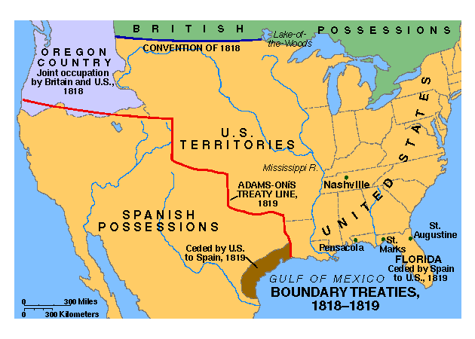
Sharing Oregon and Acquiring Florida
John Q. Adams – Monroe’s Sec. of State
Treaty of 1818 (a.k.a. Anglo-American Convention)
Includes Britain and America
Share coveted fisheries with Canada
Set the northern limits of Louisiana purchase at 49th parallel
10 yr. joint occupation of Oregon territory
Florida Purchase Treaty of 1819 (a.k.a. Adams-Onis Treaty)
Spain concerned with revolution in Latin America
Chile, Venezuela, and Argentina
Spanish ceded Florida, US gives up claims to TX

Slide 15
Sharing Oregon and Acquiring Florida – contd.
Andrew Jackson sweeps across Florida, ignoring orders from Washington.
Seizes St. Marks and Pensacola
Deposes Spanish governor
JQA – takes offensive and allows Jackson to plunder Spanish forts.
Only member of Monroe’s cabinet to do so.

Slide 16
Monroe and His Doctrine
Monroe Doctrine (1823)
US warns all of Europe to
Not colonize Latin America
Not intervene in Latin America
In return, US would stay out of European affairs
Greeks fighting the Turks for their independence.
Reinforces NATIONALISM
Europe is angry, L.A. indifferent
Doctrine has more of an impact in later years

